Slide 1
ITMS 528 Database Security & compliance implementation
Group Members:
Ishan Prabhune (A20538828)
Harshal Sawant (A20538827)
Pratik Darade (A20536376)
Raj Dedhia (A20551543)
Aniket Singh (A20546525)

Slide 2
Introduction: Enhancing Database Security, Compliance, and Project Management
This project’s main goal is to design and implement a database system that complies with NIST Special Publication 800-53 regulations.
Our joint endeavour seeks to expand on our knowledge of database security, compliance, and efficient project administration.
This implementation includes a thorough project management plan, data encryption techniques, and a MySQL database with strong security measures.
We have demonstrated our commitment to adhering to industry-standard security requirements by including NIST SP 800-53 measures.

Slide 3
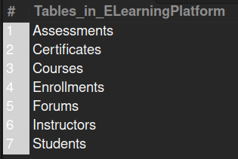
Task 1: Database Creation and Security Controls
Interconnectivity and smart design make up our database, which improves efficiency and functionality. It is made up of seven important tables, each of which is essential to the E-Learning Platform.
Every table has a specific function that adds to the overall functioning which are designed to be flexible and expand in the future.
More than a 1000 entries guarantee an accurate depiction of database utilization.

Slide 4

Implementation of NIST SP 800-53 Controls
The National Institute of Standards and Technology (NIST) Special Publication 800-53 provides a comprehensive set of security controls that organizations can implement to safeguard their information systems.
Sensitive data availability, confidentiality, and integrity are all promoted by these measures, which are made to meet a variety of security needs. A key element of the NIST Risk Management Framework (RMF) is NIST SP 800-53, which provides an organized and methodical approach to managing and reducing cybersecurity risks.
It provides Standardization, Risk Management, Compliance & Regulation, Adaptability, Continuous Improvement, Confidence & Trust and a Holistic Security Approach.

Slide 5
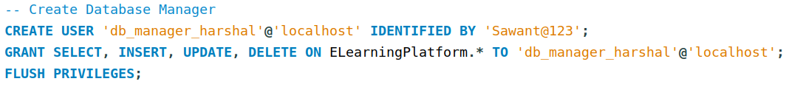
AC-02 Account Management | Privileged User Accounts:
This access control helps establish and manage accounts for privileged users in line with an attribute- or role-based access architecture. Keeping an eye on assigned privileged roles or attributes. When a privileged role or attribute assignment is no longer suitable, revoke access.
To begin with, To represent a role and its corresponding privileges, a new user is established. The user is created with the password associated with it and is meant to login from 'localhost'.
On the 'ELearningPlatform' database, the recently created user is given particular access. giving the Specific Role total authority to manipulate data in the designated database.

Slide 6
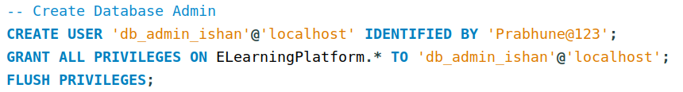
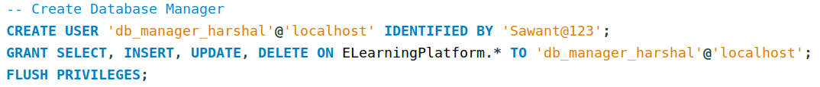
AC-05 Separation of Duties
The AC-05 Separation of Duties standards are followed while implementing access control. This approach divides responsibilities and authorization across many roles in an effort to avoid conflicts of interest and lower the possibility of fraud. In this instance, users connected to the e-learning platform have been given distinct responsibilities.
This implementation has been done during the creation of the users. By giving users different roles according to their tasks, encouraging accountability, and lowering the possibility of unapproved or conflicting acts within the e-learning platform's database, this implementation is in line with the principle of separation of duties.

Slide 7
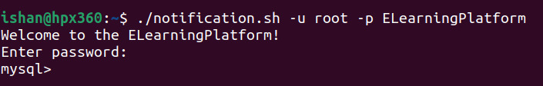
AC-08 System Use Notification
It is an access control measure that prioritizes 'System Use Notification'. By taking this precaution, users will be made aware of the system's usage guidelines as soon as they log in.
A Bash script that connects to the MySQL server and sends out a welcome message as a system use notification is used in the implementation of AC-08. Users will be made aware of the system they are engaging with when they access the ELearningPlatform via the supplied script. This procedure promotes appropriate use of the database resources and helps guarantee that users are aware of the policies governing the system.

Slide 8
AC-07 Unsuccessful Logon Attempts | Automatic Account Lock
The application of access control mechanisms in compliance with AC-07, which adds an automated account lock function and focuses on reducing security risks is associated with failed logon attempts.
The user is only permitted to perform three consecutive unsuccessful login attempts, as specified by the 'FAILED_LOGIN_ATTEMPTS 3' attribute. The account gets temporarily locked after three unsuccessful tries to log in.
The 'PASSWORD_LOCK_TIME 1' attribute indicates how long, in days, the account stays locked following the maximum amount of unsuccessful login attempts. Since it's set to one day in this instance, the account will automatically unlock after a day of being locked as a result of unsuccessful login attempts.

Slide 9
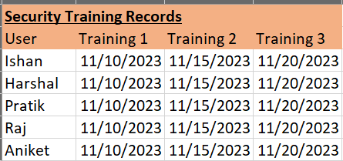
AT-04 Security Training Records
Measures for access control AT-4, "Security Training Records," deals with recording security training that is given to those who have important jobs that involve information systems.
Making sure staff members have the necessary training to carry out their security duties efficiently is the aim.
Determine Who Has Important Roles, Determine which people are primarily responsible for maintaining or utilizing the E-Learning Platform Database. Instruction in Document Security, provides a thorough security training curriculum. Enforce the prerequisites for training, Establish regulations requiring security training. Routine evaluations and audits, To make sure that every employee with access to the E-Learning Platform Database has gotten the required training.

Slide 10
AU-08 Time Stamps
The application of AU-08, an access control measure that highlights "Time Stamps" and the significance of syncing timestamps with a reliable time source. In order to keep accurate and consistent records of user activity within a database, this precaution is essential.
The 'Students' database has timestamp tracking integrated into it directly, in compliance with AU-08. Each student's last activity time is included in the timestamp, which offers a useful record for accountability, oversight, and auditing purposes. Maintaining these timestamps' precision and dependability is contingent upon synchronizing with a reliable time source, which enhances the database's overall security and integrity.

Slide 11
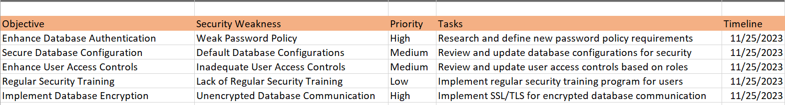
CA-05 Plan of Action and Milestones | Automation Support for Accuracy and Currency
The ‘Plan of Action and Milestones (POA&M)’ focal point of access control measure CA-05 highlights the necessity for companies to create and carry out plans to fix security flaws and vulnerabilities.
Review and update frequently, Create a routine review procedure for the POA&M.
Document Updates and Developments by Keep thorough records of any modifications performed as part of the POA&M, such as enhancements to the security posture, policy modifications, and updates to access control mechanisms.
Ensure efficient communication and coordination between security teams and database administrators to implementing security measures successfully and finishing the POA&M's tasks on time.

Slide 12
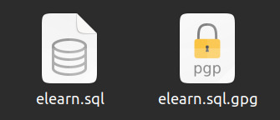
Task 2: Data encryption
Data Encryption Implementation
Ensuring the confidentiality and integrity of sensitive data is paramount to our database security strategy.
Robust encryption mechanisms are in place for both data at rest and in transit within the database.
Industry-standard encryption algorithms, such as Gnupg, have been implemented to fortify our data protection measures.
All stored data is encrypted, safeguarding it from unauthorized access, even in the event of physical storage compromise.
Schema modifications, query adjustments, and configurations were made to support and optimize encryption processes.

Slide 13
Task 3: project management plan (PMP)
This project will deliver a database with implementation of different controls using the NIST Risk Management Framework into said database. A database with over 1000 entries and more than 5 users will have a minimum of 7 tables. The creation of a database, as well as the application of control schemes, will be performed using MySQL and SQL Workbench.
Roles & Responsibilities:
DBA Administrator: Ishan Prabhune
Project Manager: Pratik Darade
DBA Manager: Harshal Sawant
DBA Designers: Raj Dedhia & Aniket Singh

Slide 14
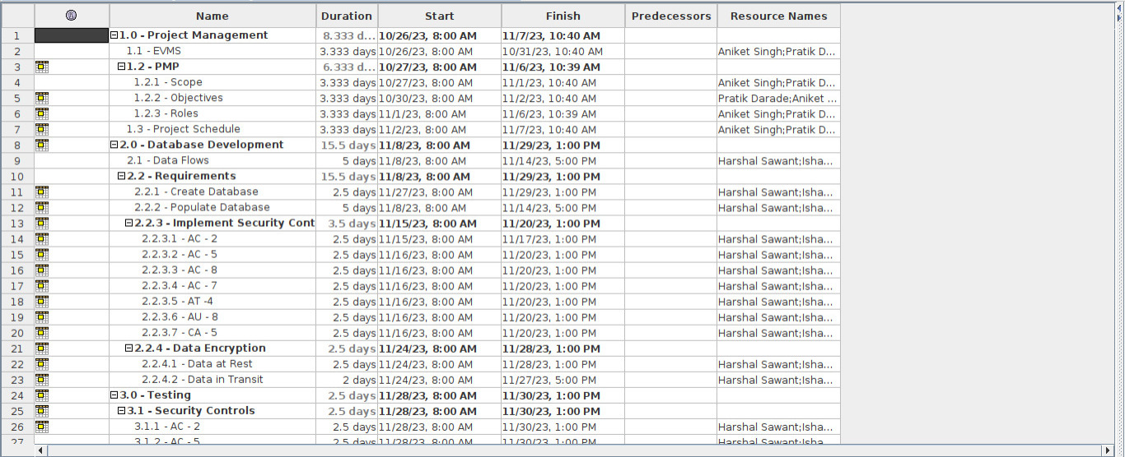
Project schedule
The Project Schedule is a detailed plan that serves as a roadmap for our project, enabling effective coordination and progress monitoring.

Slide 15
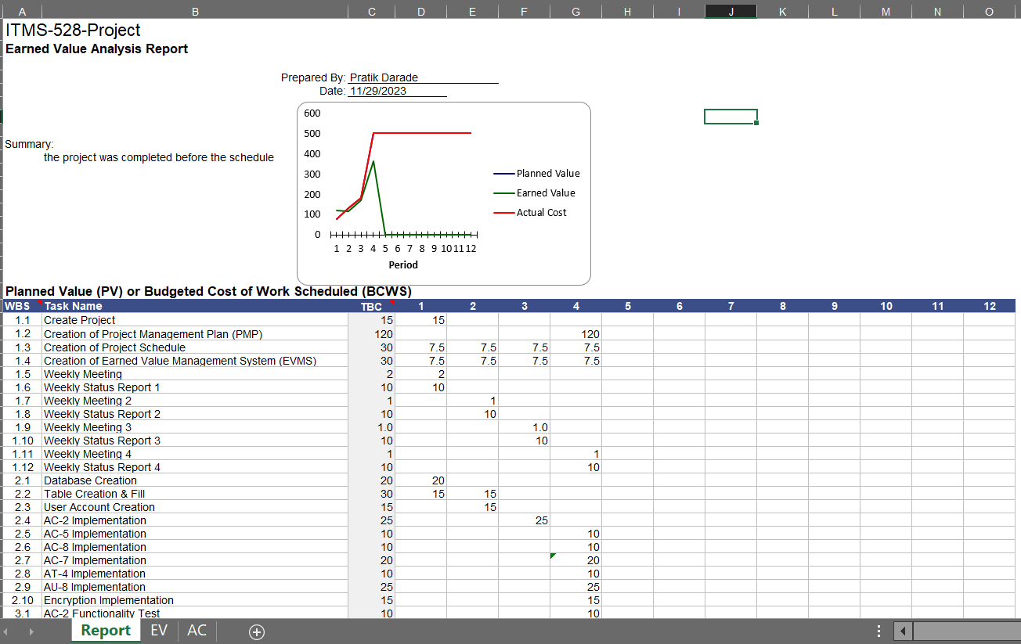
EVM

Slide 16
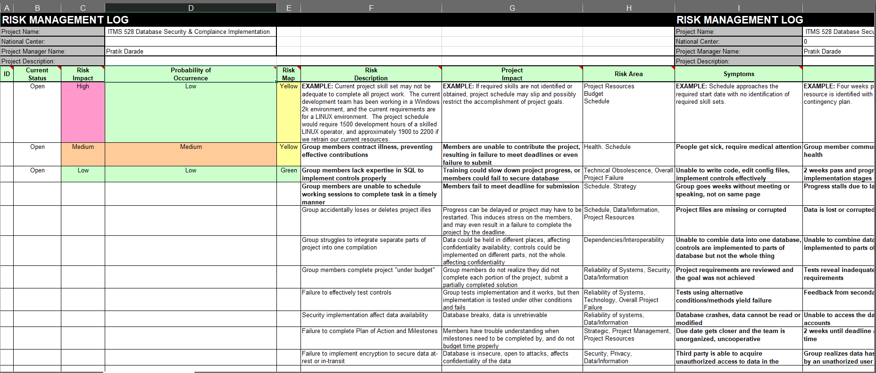
Risk management log

Slide 17
conclusion
We've successfully navigated the complexities of database creation, integrating robust security controls, implementing data encryption, and orchestrating effective project management.
The secure database system ensures the confidentiality, integrity, and availability of information, aligning with industry standards and regulations.
This project serves as a stepping stone for continuous improvement, refining both our database security practices and project management methodologies.

Slide 18
Thank you

